Slide 1
CLEAF DECORS 2017
Names needed

Slide 2
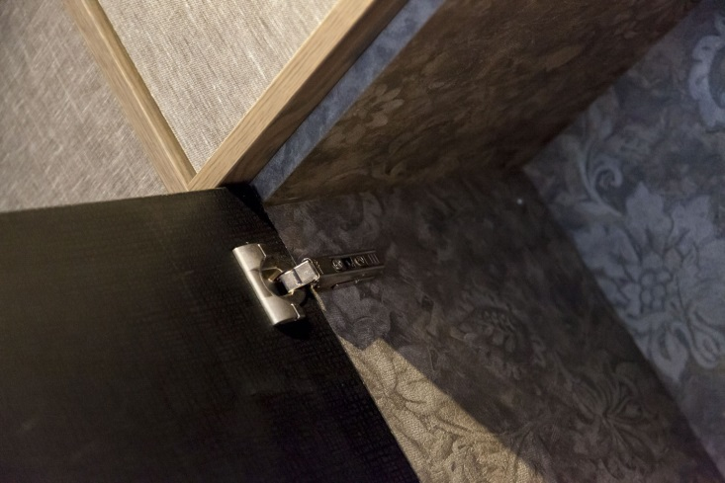
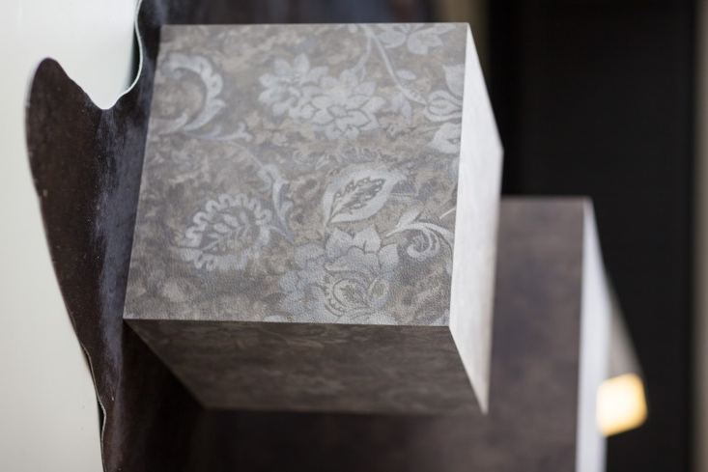
FB12 ARES
Potential name:______________________

Slide 3
SHERWOOD
LN67 SHERWOOD
LN66 SHERWOOD
Potential name:______________________
Potential name:______________________
LR09 SHERWOOD
S095 SHERWOOD
Potential name:______________________
Potential name:______________________

Slide 4
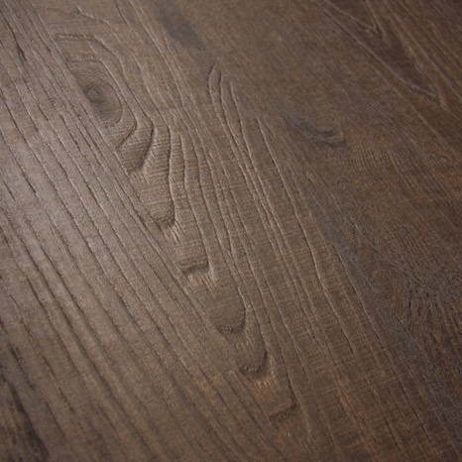
SHERWOOD cont…
S078 SHERWOOD
S071 SHERWOOD
Potential name:______________________
Potential name:______________________

